Slide 1
C# Basics

Slide 2
Mr. M.R. Solanki
Sr. Lecturer, Information Technology,
manish_ratilal2002@yahoo.com
SBMP

Slide 3
Learning Outcomes
Students will be able to:

Slide 4
C# Hello World

Slide 5
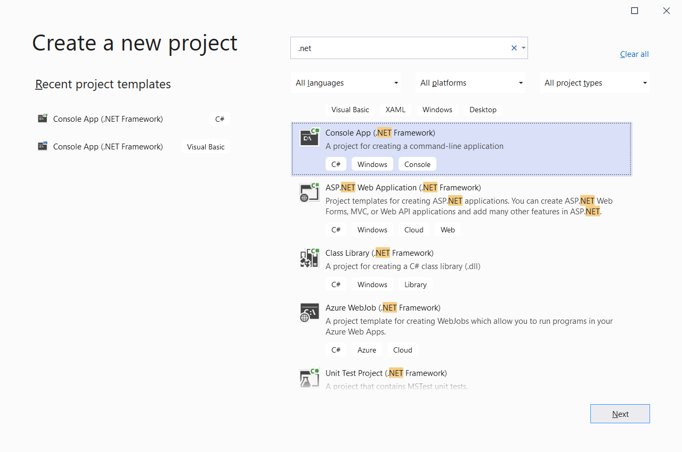
Selection of C# project
Select “Console App .NET Framework” type project

Slide 6
Hello World Program
using System;
namespace ConsoleApp1
{
public class Program
{
public static void Main(string[] args)
{
Console.WriteLine("Hello World!");
//Console.ReadLine();
Console.Read();
}
}
}
Note: We can write this program without namespace block also. Namespace is same as a package in Java.

Slide 7
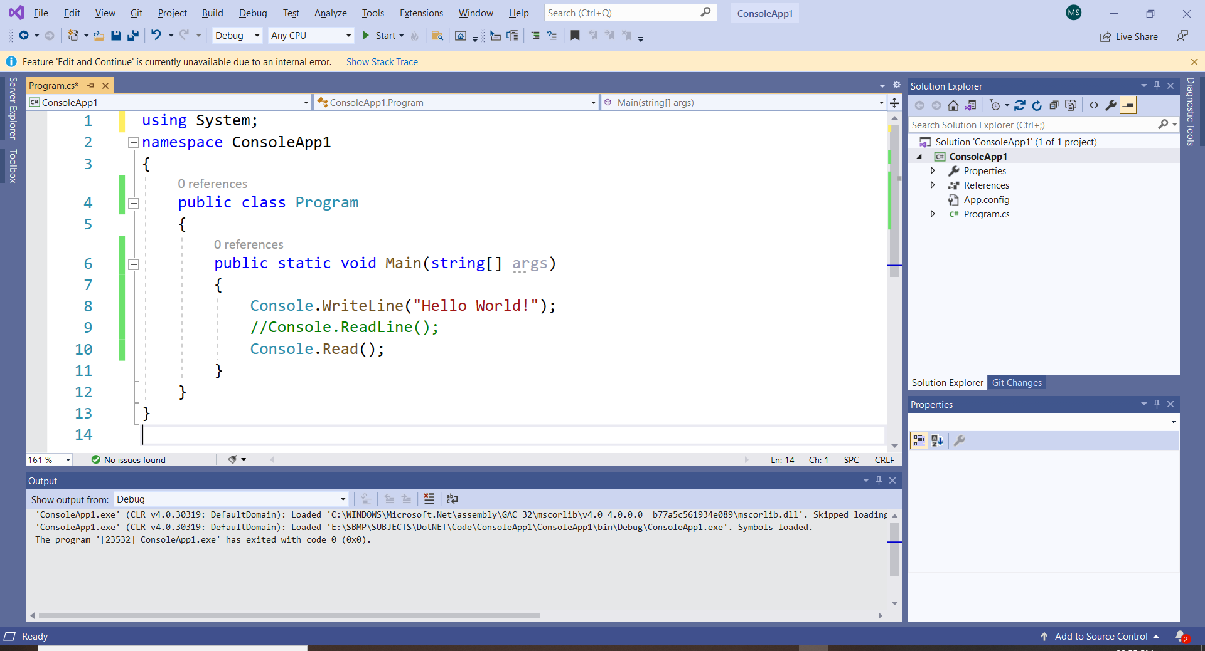

Slide 8
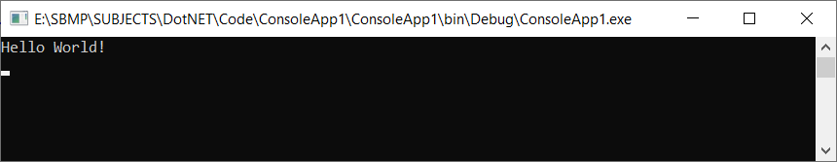
Hello World Program Output

Slide 9
Namespace
Namespaces play an important role in managing related classes in C#.
The .NET Framework uses namespaces to organize its built-in classes. For example, there are some built-in namespaces in .NET such as System, System.Linq, System.Web, etc. Each namespace contains related classes.
A namespace is a container for classes and namespaces. The namespace also gives unique names to its classes thereby you can have the same class name in different namespaces.
In C#, a namespace can be defined using the namespace keyword.

Slide 10
Namespace
Example
namespace School
{
// define classes here
}
The following namespace contains the Student and Course classes.
namespace School
{
class Student
{
}
class Course
{
}
}

Slide 11
Namespace
Classes under the same namespace can be referred to as namespace.classname syntax. For example, the Student class can be accessed as School.Student.
namespace OtherNameSpace
{
class Program
{
static void Main(string[] args)
{
School.Student std = new School.Student();
School.Course cs = new School.Course();
}
}
}

Slide 12
Namespace
To use classes under a namespace without the fully qualified name, import the namespace with the using keyword at the top of C# class file.
using System; //built-in namespace
using School;
namespace OtherNameSpace
{
class Program
{
static void Main(string[] args)
{
Student std = new Student();
}
}
}

Slide 13
Keywords
abstract | event | namespace | static
as | explicit | new | string
base | extern | null | struct
bool | false | object | switch
break | finally | operator | this
byte | fixed | out | throw
case | float | override | true
catch | for | params | try
char | foreach | private | typeof
checked | goto | protected | uint
class | if | public | ulong
const | implicit | readonly | unchecked
continue | in | ref | unsafe
decimal | int | return | ushort
default | interface | sbyte | using
delegate | internal | sealed | virtual
do | is | short | void
double | lock | sizeof | volatile
else | long | stackalloc | while
enum

Slide 14
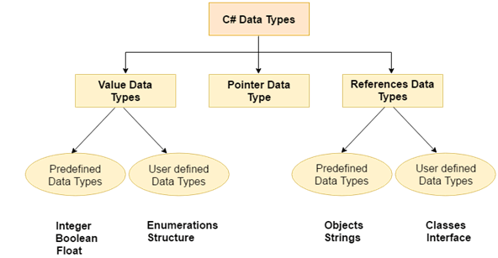
C# Data Types

Slide 15
C# Data Types
Data Types | Memory Size | Range
char or signed char | 1 byte | -128 to 127
unsigned char | 1 byte | 0 to 127
short or signed short | 2 byte | -32,768 to 32,767
unsigned short | 2 byte | 0 to 65,535
int or signed int | 4 byte | -2,147,483,648 to +2,147,483,647
unsigned int | 4 byte | 0 to 4,294,967,295

Slide 16
C# Data Types
Data Types | Memory Size | Range
Long or signed long | 8 byte | ?9,223,372,036,854,775,808 to 9,223,372,036,854,775,807
unsigned long | 8 byte | 0 - 18,446,744,073,709,551,615
float | 4 byte | 1.5 * 10⁻⁴⁵ - 3.4 * 10³⁸, 7-digit precision
double | 8 byte | 5.0 * 10⁻³²⁴ - 1.7 * 10³⁰⁸, 15-digit precision
decimal | 16 byte | ±1.0 x 10⁻²⁸ to ±7.9228 x 10²⁸

Slide 17
Identifiers
There are various rules for identifier in C#, as follows:
Names can contain letters, digits and the underscore character (_)
Names must begin with a letter
Names should start with a lowercase letter and it cannot contain whitespace
Names are case sensitive ("myVar" and "myvar" are different variables)
Reserved words (like C# keywords, such as int or double) cannot be used as names

Slide 18
In C#, single line comment is //
Multiple line comment is /*…….*/

Slide 19
Variable Declaration & Assignment
To create a variable, you must specify the type and assign it a value.
type variableName = value;
Examples:
int num = 5;
double dnum = 5.99D;
char ch = 'D';
bool b = true;
string str = "Hello";

Slide 20
Constants
Constant variables can not be changed so they become read-only:
const int num = 35;
num = 20; // error

Slide 21
Writing & Reading data to and from the User
Console.WriteLine() is used to output (print) values.
Console.ReadLine() is used to get user input.
Console.WriteLine("Enter username:");
string userName = Console.ReadLine();
Console.WriteLine("Username is: " + userName);
Console.WriteLine("Enter your age:");
int age = Convert.ToInt32(Console.ReadLine());
Console.WriteLine("Your age is: " + age);
Note: When we get user input data, its’ default type is string so we have to type cast it into desired type.

Slide 22
Type Casting
When you assign a value of one data type to another type is called Type Casting.
In C#, there are two types of casting:
Implicit Casting (automatically/widening) - converting a smaller type to a larger type size
char -> int -> long -> float -> double
Explicit Casting (manually/narrowing) - converting a larger type to a smaller size type
double -> float -> long -> int -> char

Slide 23
Type Casting
Implicit Casting:
int i = 19;
double d = i;
Console.WriteLine(i);
Console.WriteLine(d);
Explicit Casting:
double d = 9.78;
int i = (int) d;
Console.WriteLine(d);
Console.WriteLine(i);

Slide 24
Type Conversion Methods
It is also possible to convert data types explicitly by using built-in methods, such as Convert.ToBoolean, Convert.ToDouble,Convert.ToSingle(), Convert.ToString, Convert.ToInt32 (int) and Convert.ToInt64 (long):
int i = 12;
double d = 3.25;
bool b = true;
Console.WriteLine(Convert.ToString(i));
Console.WriteLine(Convert.ToDouble(i));
Console.WriteLine(Convert.ToInt32(d));
Console.WriteLine(Convert.ToString(b));

Slide 25
Thanks!
Any questions?
You can find me at:
manish_ratilal2002@yahoo.com

Slide 26
Credits
https://www.javatpoint.com/

